Slide 1
IDS 462 Lecture 8
Finish Model Comparison
Time Series Analysis
Can We Make Money on the S&P 500?

Slide 2
Review Project from Last Week
3 different model types
  Logistic regression, CHAID, Neural Nets
Client has two functions to maximize
  Profit and ROI
Does maximizing one come close to reaching the max of the other?
What technical choices did you make (really accepted the default choices) in order to build the CHAID and Neural net ‘models’
Re-run profit and ROI equation and get max of maximums
Let’s make an outline based on the questions on the next page

Slide 3
Business Question for Memo
The client says: The finance department wants me to cut my mail quantities to maximize the ROI for my mailings. Please use the major analytic techniques for response variables and tell me where I should cut the mail quantity to maximize ROI
But I also have to produce a certain amount of profit for my boss. So, could I cut it somewhere else to maximize the profit?
ADDIDITION: For both of the cuts above, tell me what percent of the total mail file I need to mail and what percent of the total sales I can expect to get
For the two cut points above, does one of them do a better job of meeting both goals?
Just for my understanding, tell me what techniques you used, and please show me the profit & revenue curve for all of them

Slide 4
Next Project
Introduction to Time Series Analysis
Use it To Trade on S&P 500

Slide 5
The Basics of Time Series
There are two ways of characterizing data that varies over time
  Moving Average
  Autoregressive
Each discussed in detail

Slide 6
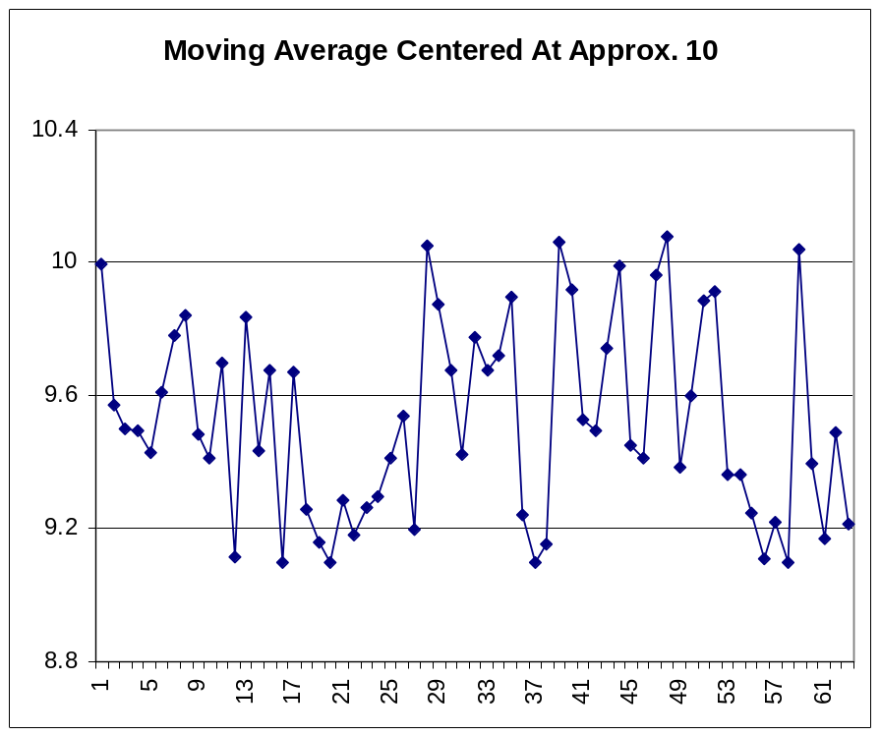
Moving Average
Example: A family on a budget
If a big expense hits this month, they can’t spend as much next month
So the data points bounce around a fixed mean

Slide 7
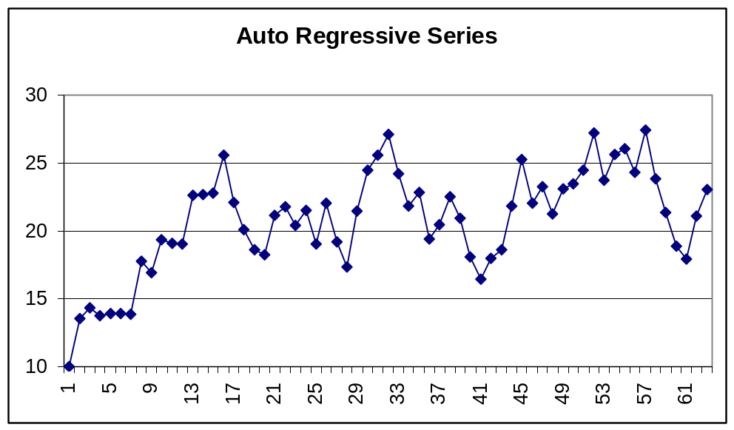
Auto Regressive Series
Auto Regressive series, however, are characterized by the fact that the data at point t has a correlation with the data at point at t-1
Graphs of these series will show irregular but repeating bumps

Slide 8
Equation for An AR(1) Series
Since the AR series shows correlation between data at t and at t-1 the formula for such a series is
  Y_{t}=C+Φ₁Y_{t-1}+a_{t}
  Where a_{t} is a random error
  C is a constant (mean)
  So the main thing we attempt to estimate is Φ₁
This is just like a regression equation with
  Data at t is the Y variable
  Data at t-1 is the X variable

Slide 9
AR(1) vs. AR(2) and AR(P)
Note that the equation on the previous page assumed a correlation between Y_{t} and Y_{t-1}
  Y_{t}=C+Φ₁Y_{t-1}+a_{t}
This is called an AR(1) process
If there is ALSO a correlation between Y_{t} and Y_{t-2} then the model is an AR(2) process
  Y_{t}=C+Φ₁Y_{t-1}+ Φ₂Y_{t-2}+a_{t}
This is generalized to correlations between Y_{t} and Y_{t-p} and is therefore called an AR(P) series
The general idea is that the series is a function of its past values and some random error

Slide 10
Moving Average [MA(Q)] Models
Now, remember the family on the budget
A big expense at t-1 (or last month) affected the money available at t (this month)
  But they can also have unexpected expenses this month
So these series are loosely a function of their past random shocks and some random error
So the formula for an MA(1) model is
  Y_{t}=a_{t}-θ₁a_{t-1} Remember that a_{t} is a random number
The formula for an MA(2) model is similarly
  Y_{t}=a_{t}-θ₁a_{t-1}- θ₂a_{t-2}

Slide 11
Some Series Have Both
Some data series may have elements of both an AR and an MA process
These are called ARMA models
Using both AR and MA terms in a model, and going back enough time periods (called lags) we can fit a model to almost any series of time series data
What about over fitting?

Slide 12
Steps To Estimate TS in SAS
Evaluate series for Stationarity
  Fixed mean and consistent variance
Difference series to make it stationary as needed
Look at pattern of ACF (auto-correlation functions) and PACF (partial auto-correlation function) to tentatively specify model
Evaluate statistical significance of model terms
Adjust and fine-tune
Evaluate out-of-sample forecasts
  Check against over fitting

Slide 13
Stationarity
Stationarity is a CRUCIAL theoretical assumption in specifying time series models
If data are not stationary, then estimates for variance are not valid
Why is this important?
  Think regression modeling
If series is not stationary, then differencing enough times will make it stationary
Differencing means you subtract Y_{t-1} from Y_{t} and call that your new series– build your model on it

Slide 14
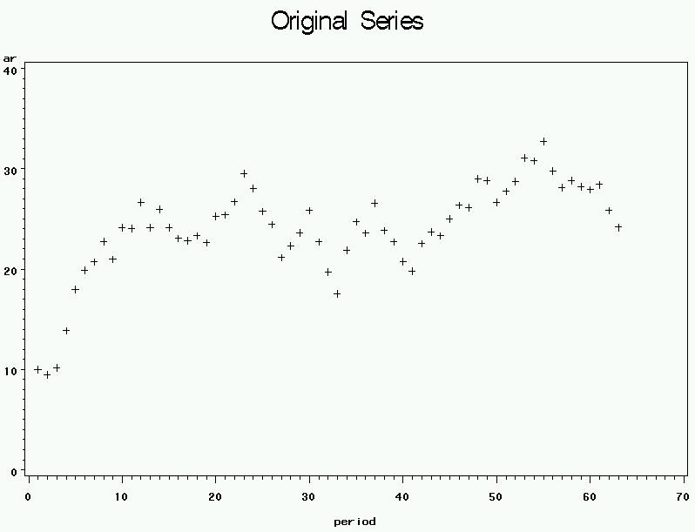
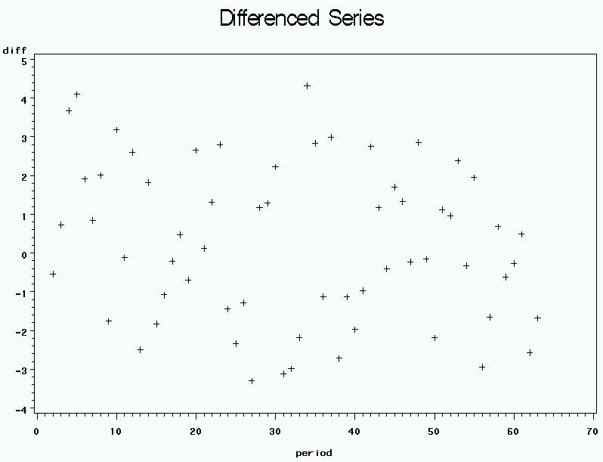
Original AR vs. Differenced
Original series does not appear stationary but differenced series does appear stationary
How to tell for sure? Stationarity test in SAS

Slide 15
Staionarity Test
Open the program ARDemo.sas and run to
/*Stop Here For First Part*/
Look at Augmented Dickey Fuller Unit Root Test for Original Series (last page of output)
Generally, the p-values are non-significant
  So the series is not stationary

Slide 16
Stationarity for 1st Order Difference
So look at the same test for the differenced series
Run next block that has ar(1)
Now all p-values are very small
  So first differencing stabilized the series
  That is, made it stationary

Slide 17
Model Identification
Look at Autocorrelation Function (ACF) graphic and Partial Autocorrelations (PACF) graphic
The ACF gives you the value of the correlation between the t and t-1, t and t-2, etc.
So big numbers means that the correlation is potentially significant
This is displayed graphically on the chart
  The small dots are the 95% confidence bounds
  The asterisks represent the value of the ACF for that lag
So what if a row of asterisks comes out and touches the little dot?

Slide 18
Model Identification
The PACF represents the strength of the correlation between t and t-2 after the correlation between t and t-1 is accounted for
  Just like any other partial correlation
Again displayed graphically with asterisks and dots
What about the Inverse Autocorrelation?
  Don’t ask me

Slide 19
Model Identification
A significant ‘spike’ on the ACF at lag(q) suggests that the qth order MA term is significant and is a candidate for inclusion in a model
A significant spike on the PACF at lag(p) suggests that the pth order AR term is significant and should be included in a model
What do these graphs show for our model

Slide 20
Identify Our Series
For the example AR series I provided the graphs indicate absolutely nothing
This can happen sometimes
Even though the correlation was moderately strong between t and t-1, after differencing there was no longer any structure in the series

Slide 21
Chi-Square Test for White Noise
This is confirmed statistically by looking at the part of the output labeled
Autocorrelation Check for White Noise
The chi-square tests for whether any of the autocorrelations through lag 6 are significant, then through lag 12, etc.
None of the p-values are close to significant

Slide 22
Estimate Model Anyway
For demonstration purposes we can estimate the AR(1) coefficient with the last block of code
P-value is not significant
In time series terminology we would say that after differencing this series is ‘white noise’
  That is, there is no remaining structure in the data (that is detected statistically)
That wasn’t very satisfying, so let’s do the MA series
  Open the program MADemo.sas

Slide 23
Stationarity for MA
Look at the FULL set of Stationarity tests
  What do they tell us
Here we have to distinguish between the zero mean and single mean test
Does this series have a zero mean
So what is the appropriate test?
What does it tell us?

Slide 24
Identify Model
The first and third spikes on the ACF are moderately close to significant
If we model for the first MA term, what do we see?
What does this mean?
  It means your instructor doesn’t have enough experience creating time series data sets with significant terms relative to the random error

Slide 25
Time Series Model for S&P 500
Let’s put this to use by pulling the monthly data for the S&P 500, building a model, and seeing if we could make any money using the model
[Probably next time]
This will form the basis of your next (relatively short) memo

